Slide 1

Database Principles:
Fundamentals of Design, Implementation, and Management
Tenth Edition
Chapter 9
Normalizing Database Designs

Slide 2
Objectives
In this chapter, students will learn:
  What normalization is and what role it plays in the database design process
  About the normal forms 1NF, 2NF, 3NF, BCNF,
  and 4NF
  How normal forms can be transformed from lower normal forms to higher normal forms
  That normalization and ER modeling are used concurrently to produce a good database design
  That some situations require denormalization to generate information efficiently

Slide 3
Database Tables and Normalization
Normalization
  Process for evaluating and correcting table structures to minimize data redundancies
    Reduces data anomalies
  Series of stages called normal forms:
    First normal form (1NF)
    Second normal form (2NF)
    Third normal form (3NF)

Slide 4
Database Tables and Normalization (cont’d.)
Normalization (continued)
  2NF is better than 1NF; 3NF is better than 2NF
  For most business database design purposes, 3NF is as high as needed in normalization
  Highest level of normalization is not always most desirable
Denormalization produces a lower normal form
  Increased performance but greater data redundancy

Slide 5
The Need for Normalization
Example: company that manages building projects
  Charges its clients by billing hours spent on each contract
  Hourly billing rate is dependent on employee’s position
  Periodically, report is generated that contains information such as displayed in Table 6.1

Slide 6
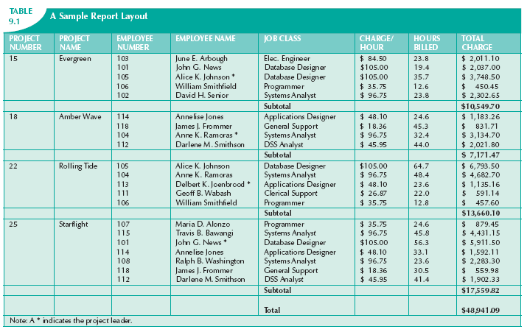

Slide 7
The Need for Normalization (cont’d.)
Structure of data set in Figure 6.1 does not handle data very well
Table structure appears to work; report is generated with ease
Report may yield different results depending on what data anomaly has occurred
Relational database environment is suited to help designer avoid data integrity problems

Slide 8
The Normalization Process
Each table represents a single subject
No data item will be unnecessarily stored in more than one table
All nonprime attributes in a table are dependent on the primary key
Each table is void of insertion, update, and deletion anomalies

Slide 9
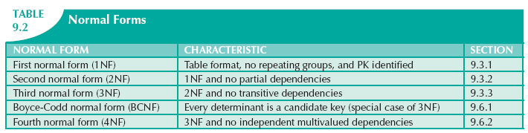

Slide 10
The Normalization Process (cont’d.)
Objective of normalization is to ensure that all tables are in at least 3NF
Higher forms are not likely to be encountered in business environment
Normalization works one relation at a time
Progressively breaks table into new set of relations based on identified dependencies

Slide 11
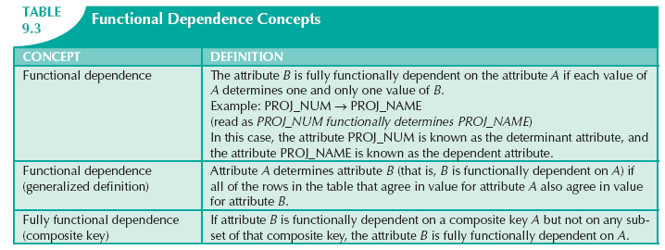

Slide 12
The Normalization Process (cont’d.)
Partial dependency
  Exists when there is a functional dependence in which the determinant is only part of the primary key
Transitive dependency
  Exists when there are functional dependencies such that X → Y, Y → Z, and X is the primary key

Slide 13
Conversion to First Normal Form
Repeating group
  Group of multiple entries of same type can exist for any single key attribute occurrence
Relational table must not contain repeating groups
Normalizing table structure will reduce data redundancies
Normalization is three-step procedure

Slide 14
Conversion to First Normal Form (cont’d.)
Step 1: Eliminate the Repeating Groups
  Eliminate nulls: each repeating group attribute contains an appropriate data value
Step 2: Identify the Primary Key
  Must uniquely identify attribute value
  New key must be composed
Step 3: Identify All Dependencies
  Dependencies are depicted with a diagram

Slide 15
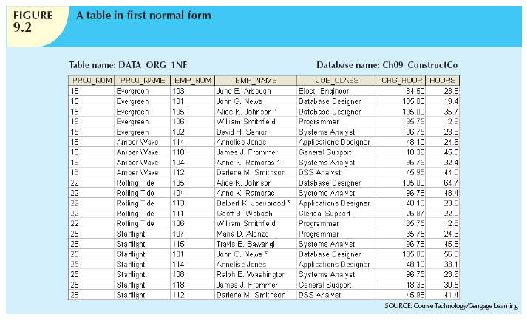

Slide 16
Conversion to First Normal Form (cont’d.)
Dependency diagram:
  Depicts all dependencies found within given table structure
  Helpful in getting bird’s-eye view of all relationships among table’s attributes
  Makes it less likely that you will overlook an important dependency

Slide 17
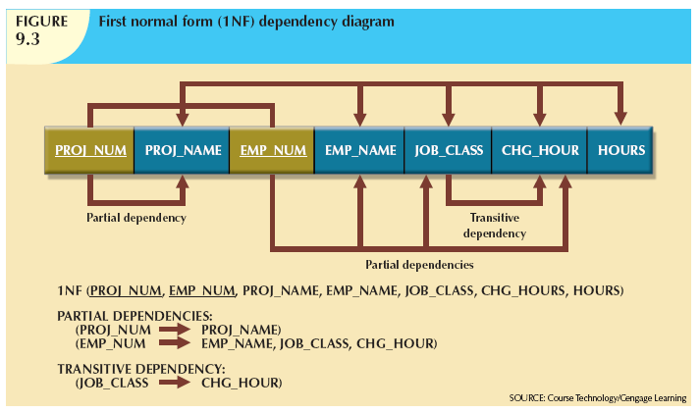

Slide 18
Conversion to First Normal Form (cont’d.)
First normal form describes tabular format:
  All key attributes are defined
  No repeating groups in the table
  All attributes are dependent on primary key
All relational tables satisfy 1NF requirements
Some tables contain partial dependencies
  Dependencies are based on part of the primary key
  Should be used with caution

Slide 19
Conversion to Second Normal Form
Step 1: Make New Tables to Eliminate Partial Dependencies
  Write each key component on separate line, then write original (composite) key on last line
  Each component will become key in new table
Step 2: Reassign Corresponding Dependent Attributes
  Determine attributes that are dependent on other attributes
  At this point, most anomalies have been eliminated

Slide 20
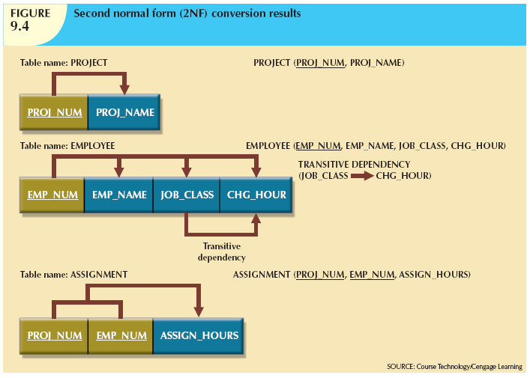

Slide 21
Conversion to Second Normal Form (cont’d.)
Table is in second normal form (2NF) when:
  It is in 1NF and
  It includes no partial dependencies:
    No attribute is dependent on only portion of primary key

Slide 22
Conversion to Third Normal Form
Step 1: Make New Tables to Eliminate Transitive Dependencies
  For every transitive dependency, write its determinant as PK for new table
  Determinant: any attribute whose value determines other values within a row

Slide 23
Conversion to Third Normal Form (cont’d.)
Step 2: Reassign Corresponding Dependent Attributes
  Identify attributes dependent on each determinant identified in Step 1
    Identify dependency
  Name table to reflect its contents and function

Slide 24
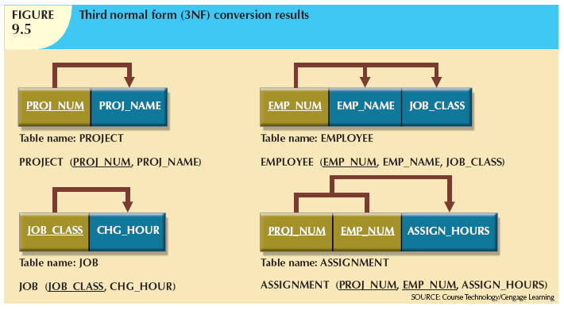

Slide 25
Conversion to Third Normal Form (cont’d.)
A table is in third normal form (3NF) when both of the following are true:
  It is in 2NF
  It contains no transitive dependencies

Slide 26
Improving the Design
Table structures should be cleaned up to eliminate initial partial and transitive dependencies
Normalization cannot, by itself, be relied on to make good designs
Valuable because it helps eliminate data redundancies

Slide 27
Improving the Design (cont’d.)
Issues to address, in order, to produce a good normalized set of tables:
  Evaluate PK Assignments
  Evaluate Naming Conventions
  Refine Attribute Atomicity
  Identify New Attributes

Slide 28
Improving the Design (cont’d.)
  Identify New Relationships
  Refine Primary Keys as Required for Data Granularity
  Maintain Historical Accuracy
  Evaluate Using Derived Attributes

Slide 29
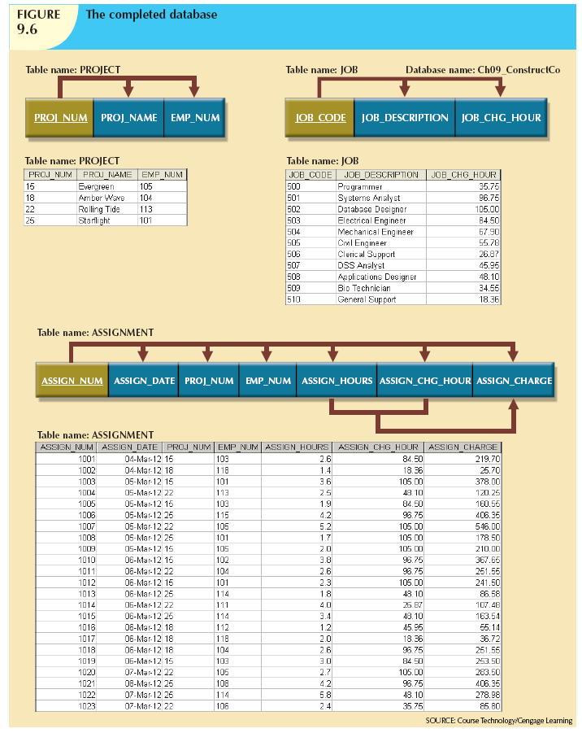

Slide 30
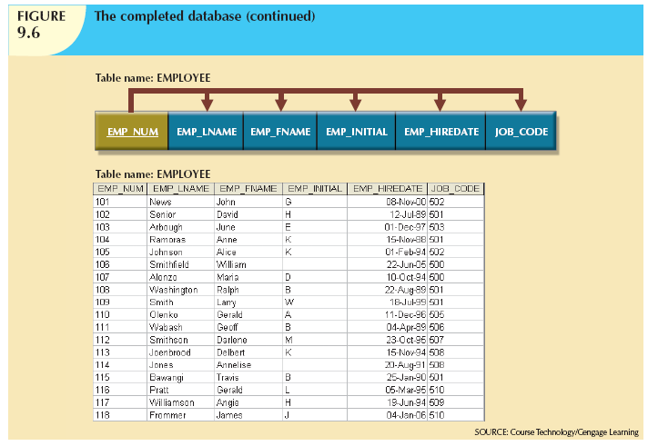

Slide 31
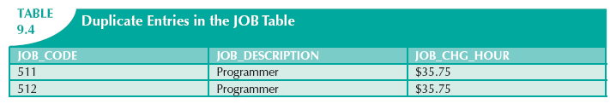
Surrogate Key Considerations
When primary key is considered to be unsuitable, designers use surrogate keys
Data entries in Table 6.4 are inappropriate because they duplicate existing records
  No violation of entity or referential integrity

Slide 32
Higher-Level Normal Forms
Tables in 3NF perform suitably in business transactional databases
Higher-order normal forms are useful on occasion
Two special cases of 3NF:
  Boyce-Codd normal form (BCNF)
  Fourth normal form (4NF)

Slide 33
The Boyce-Codd Normal Form
Every determinant in table is a candidate key
  Has same characteristics as primary key, but for some reason, not chosen to be primary key
When table contains only one candidate key, the 3NF and the BCNF are equivalent
BCNF can be violated only when table contains more than one candidate key

Slide 34
The Boyce-Codd Normal Form (cont’d.)
Most designers consider the BCNF as a special case of 3NF
Table is in 3NF when it is in 2NF and there are no transitive dependencies
Table can be in 3NF and fail to meet BCNF
  No partial dependencies, nor does it contain transitive dependencies
  A nonkey attribute is the determinant of a key attribute

Slide 35
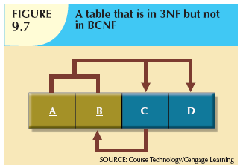

Slide 36
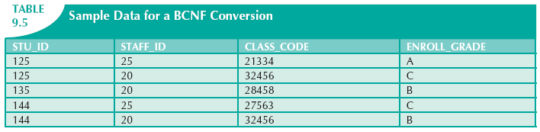

Slide 37
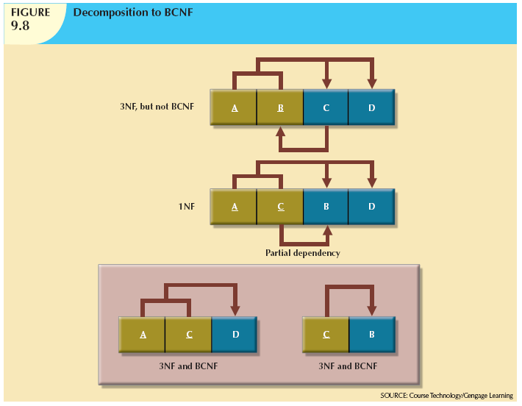

Slide 38
Fourth Normal Form (4NF)
Table is in fourth normal form (4NF) when both of the following are true:
  It is in 3NF
  No multiple sets of multivalued dependencies
4NF is largely academic if tables conform to following two rules:
  All attributes dependent on primary key, independent of each other
  No row contains two or more multivalued facts about an entity

Slide 39
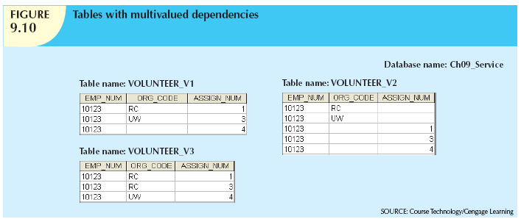

Slide 40
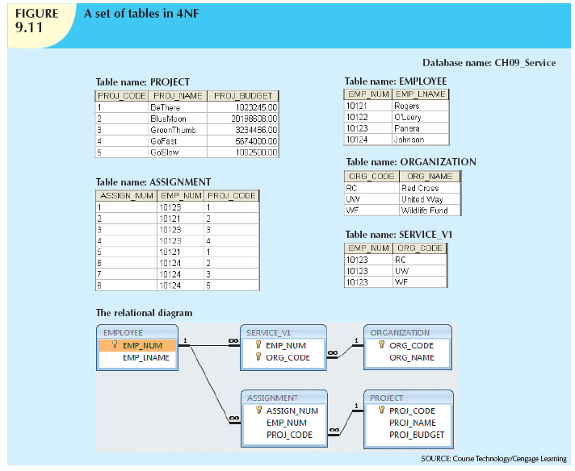

Slide 41
Normalization and Database Design
Normalization should be part of the design process
Make sure that proposed entities meet required normal form before table structures are created
Many real-world databases have been improperly designed or burdened with anomalies
You may be asked to redesign and modify existing databases

Slide 42
Normalization and Database Design (cont’d.)
ER diagram
  Identify relevant entities, their attributes, and their relationships
  Identify additional entities and attributes
Normalization procedures
  Focus on characteristics of specific entities
  Micro view of entities within ER diagram
Difficult to separate normalization process from ER modeling process

Slide 43
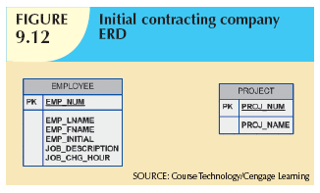

Slide 44
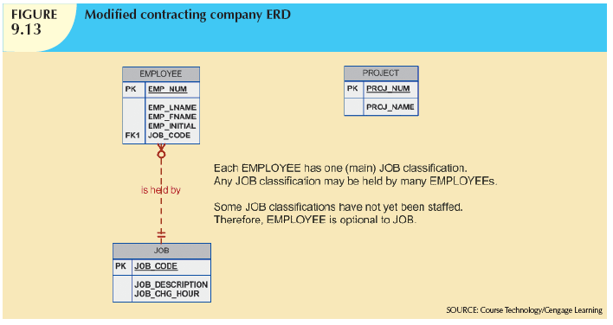

Slide 45
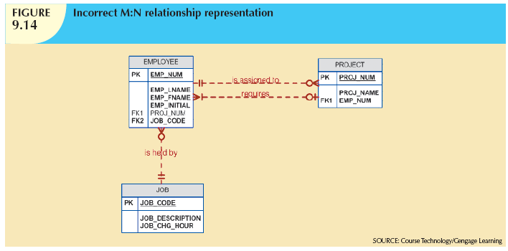

Slide 46
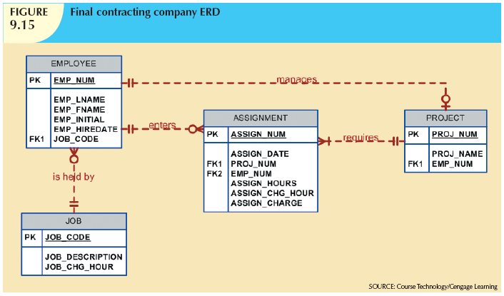

Slide 47
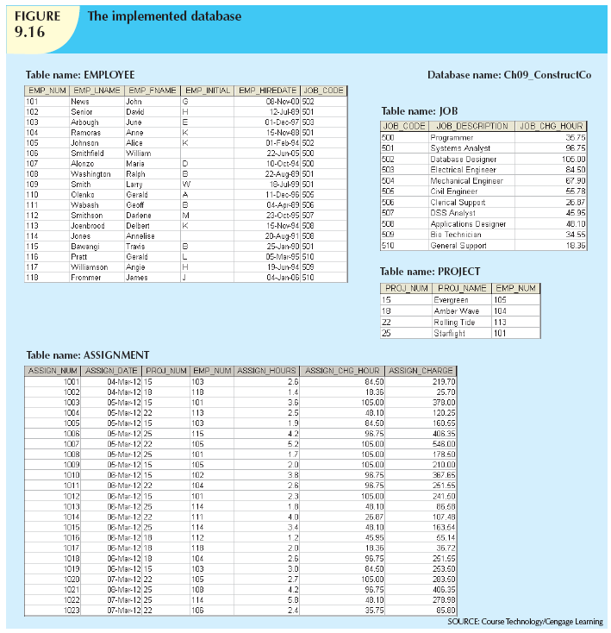

Slide 48
Denormalization
Creation of normalized relations is important database design goal
Processing requirements should also be a goal
If tables are decomposed to conform to normalization requirements:
  Number of database tables expands

Slide 49
Denormalization (cont’d.)
Joining the larger number of tables reduces system speed
Conflicts are often resolved through compromises that may include denormalization
Defects of unnormalized tables:
  Data updates are less efficient because tables are larger
  Indexing is more cumbersome
  No simple strategies for creating virtual tables known as views

Slide 50
Data-Modeling Checklist
Data modeling translates specific real-world environment into data model
  Represents real-world data, users, processes, interactions
Data-modeling checklist helps ensure that data-modeling tasks are successfully performed
Based on concepts and tools learned in Part II

Slide 51
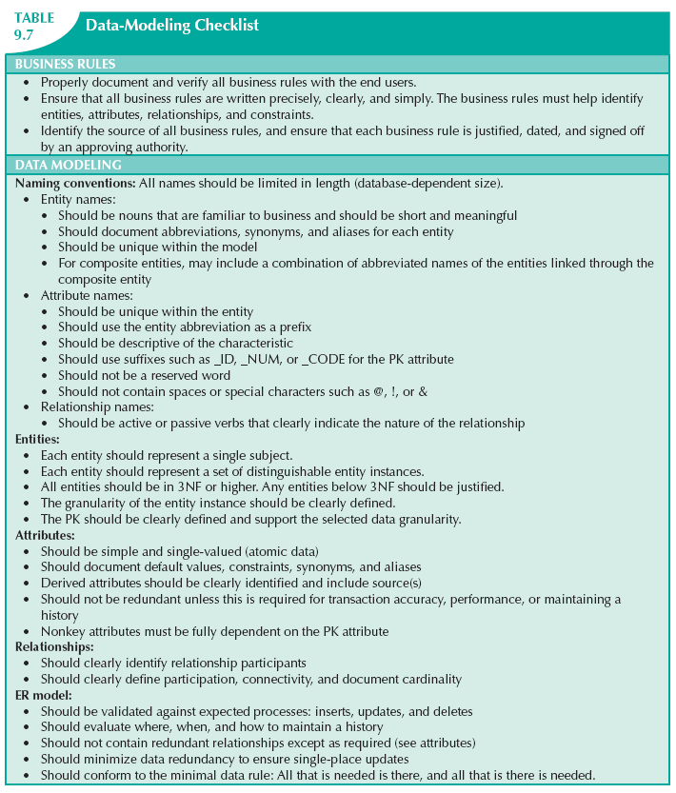

Slide 52
Summary
Normalization minimizes data redundancies
First three normal forms (1NF, 2NF, and 3NF) are most commonly encountered
Table is in 1NF when:
  All key attributes are defined
  All remaining attributes are dependent on primary key

Slide 53
Summary (cont’d.)
Table is in 2NF when it is in 1NF and contains no partial dependencies
Table is in 3NF when it is in 2NF and contains no transitive dependencies
Table that is not in 3NF may be split into new tables until all of the tables meet 3NF requirements
Normalization is important part—but only part—of the design process

Slide 54
Summary (cont’d.)
Table in 3NF may contain multivalued dependencies
  Numerous null values or redundant data
Convert 3NF table to 4NF by:
  Splitting table to remove multivalued dependencies
Tables are sometimes denormalized to yield less I/O, which increases processing speed

